Slide 1

“The aging workforce is a powerful force that provides tremendous value to a business and deserves planning and protection.”
    https://www.safetyandhealthmagazine.com/articles/18302-managing-an-aging-workforce

Slide 2
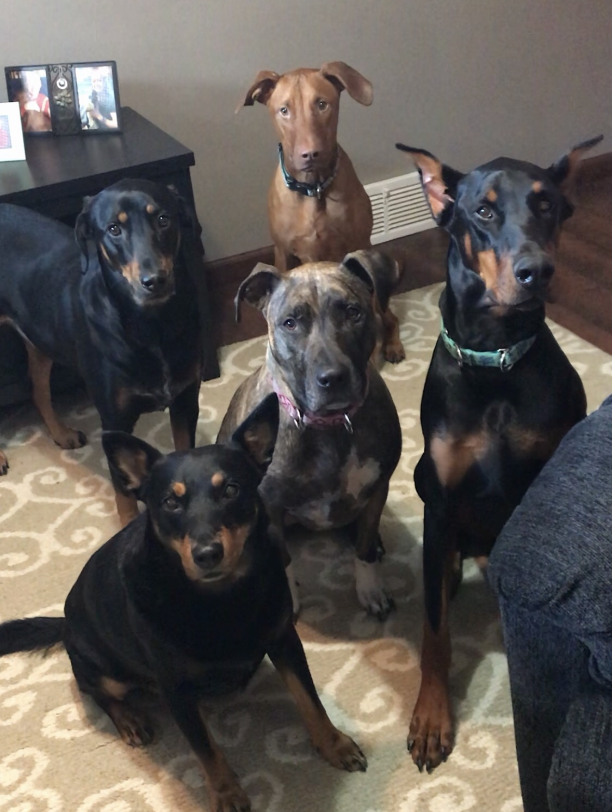
Notes:
to start the class…..
Until told not to
Makes me happy hope it makes you happy
Fostering – what happens when bad at saying no
NALOXONE – Opioid overdose reversal medication
Local police – news
15 min fame – big head

Slide 3

Safety for senior workers
Colleen M. Bolha, CSP, CHST
Notes:
Intro self
who thinks they are not a part of this category of this presentation
Be prepared!
..should be able to relate
Difficulty hiring
Americans are working longer than ever
That’s why it’s more important than ever to take care of the workers we have and the aging ones in particular.
So they can work as long as they want

Slide 4
To do:
Explore potential safety risk factors associated with the aging workforce.
Help employers get a better understanding of physical and psychological changes that occur as workers age.
Provide information to assist employers to adapt for safety and health issues pertaining to the aging workforce.
Keep experienced workers safe and productive!
Notes:
Look at risk factors
Look at some safety issues may put our older workers at a higher risk for certain injuries
Understand what kind of changes take place as we age
Take of look at what we can change in the workplace to be better equipped to keep older workers safe

Slide 5

What is an older worker?
How we age differs for everyone
“Older” worker may differ depending on job
Physical demands
Construction worker
Arborist
Office worker
Firefighter
Accountant
Notes:
Generally speaking, you’ll see we will be looking at age groups typically 55 and over but will look at a wide range…
No distinct line
We do kind of all age differently – who know what life throws at us
Physically taxing/demanding occupations – arborist, compared to more sedentary occupations
Tree service demonstration
firefighter (dad retired at 55 –old for firefighter)– median ages vary
Major league baseball players or pro football players 20’s??
THINGS that influence working *health *workplace environment * job demands *belief in your work ability.

Slide 6
AGE DESCRIMINATION IN EMPLOYMENT ACT OF 1967
The Age Discrimination in Employment Act (ADEA) forbids age discrimination against people who are age 40 or older.
The law prohibits discrimination in any aspect of employment, including hiring, firing, pay, job assignments, promotions, layoff, training, benefits, and any other term or condition of employment.
Both the Age Discrimination Employment Act of 1967 and the Americans with Disabilities Act of 1990 prohibit workplace discrimination based on age or disability, respectively, and support the retention of qualified workers despite limitations that may come from age or disability.
https://www.eeoc.gov/laws/types/age.cfm
Notes:
The Age Discrimination in Employment Act forbids age discrimination against people who are age 40 or older.
The law prohibits discrimination in any aspect of employment.

Slide 7
STATS
The Centers for Disease Control and Prevention states, citing data from the Bureau of Labor Statistics:
1 in every 5 American workers is over 65
In 2020, 1 in 4 American workers will be over 55
Notes:
The retirement age seems to increase with each passing year as some individuals choose to stay in the workforce for a variety of reasons.
*fear of not knowing what to do in retirement,
*not being financially secure enough to comfortably enjoy retirement.
*HEALTHCARE
no denying workers are staying on the job longer

Slide 8
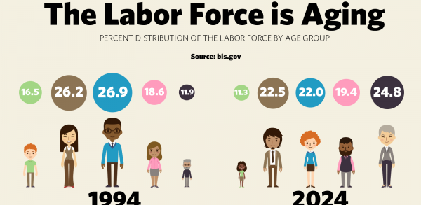
Notes:
Illustration of the aging work force
94 to projected 2024 -
Highest populations on the bookends
Are you finding it difficult to find enough people to take over the jobs of retiring workforce??
…….. so retirees are often asked to stay.

Slide 9
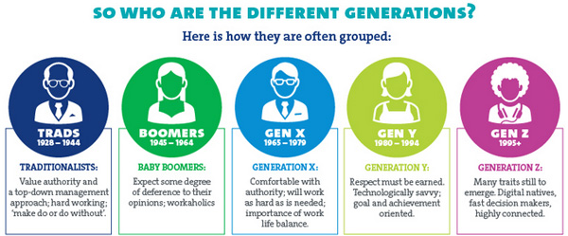
Notes:
Baby-boomers are now between ages of 54-74 (making up that ¼ of workforce mentioned)
With different generation emerge different characteristics, issues, learning preferences. (strictly generalizations about the different age groups.)
Understanding these differences will help when communicating and to be respectful of these differences.
Traditionalists – work ethic like we may never see again…great depression. Ive been fortunate enough to be able to work every day…vacation time..I can’t take an hour w/o 10 questions..
Then multiplies from there…2 hurs…20 questions
After 1995 “generation z”

Slide 10

AGING AND PHYSICAL CHANGES
AGE 25 = Physical maturity
Age 40-50 = Most people first start to notice changes due to aging
Notes:
Around 40 is when people tend to NOTICE changes due to aging but changes do start even earlier than this..

Slide 11
Age associated Changes
Biological
Physical
Cognitive
Social
Notes:
So many changes we need to categorize them!
‘BENEFITS OF AGING”
Biological – Changes in metabolism (weight gain), changes at the cellular level - regeneration of tissue/cells (takes longer to recuperate after an injury)
Physical – loss of muscle mass, loss of strength, stability
Cognitive – multi-tasking decreases, mood
Social –loss of family, friends, empty-nesters, feeling of loss of friends if we leave work
Lets face it, work is a big part of our social life.

Slide 12
TRUE OR FALSE?
Verbal tasks and vocabulary decline with age.

Slide 13
FALSE!
Verbal tasks and vocabulary remain constant or improve!
Notes:
Starting on positive note!
Big word
But not wordsmith…

Slide 14
Aging on the brain
Brain shrinks with aging – included are parts of the brain important to learning and complex mental activities.
Communication between neurons (nerve cells) may reduce. - Cell support, metabolism.
Blood flow to the brain may decrease. - Although the brain is only 2 percent of the body's weight, it receives 20 percent of the body's blood supply.
Inflammation may increase.
https://www.nia.nih.gov/health/how-aging-brain-affects-thinking
Notes:
CHANGES COME WITH THE AGING PROCESS.
LOOK AT AS – BENEFITS of AGING!!!!!!
Jumble, crossword, race track – STUDY THE RACING forms (dads excuse to go)-exercise the mind
10 cent better – lecture NEVER PLAY SLOTS
(Some brain changes, like those associated with Alzheimer's disease, are NOT a normal part of aging.

Slide 15
Aging on the brain
LEARNING AND COGNITIVE FUNCTIONING
  May not think as quickly/clearly
  May take longer to learn new skills
FLUID INTELLIGENCE
  (deductive reasoning/dual-task activities/information processing) declines with age.
https://www.nia.nih.gov/health/how-aging-brain-affects-thinking
Notes:
Difficulty working in a busy environment where lots going on.
Employer – lessen stimuli – help focus on task
Multi-tasking ability may decline
Misplaced keys…
Who’s panicked looking for the cell phone that you’re literally talking on?
What did I come in the kitchen for?
Older folks may not be as quick to learn compared to younger but they are certainly more than capable of doing so

Slide 16
TRUE OR FALSE?
The most common health condition affecting workers over age 55 is hearing loss.
Notes:
If false, what do you think it is?????

Slide 17
FALSE!
  Arthritis - 47%
Notes:
Arthritis is the most prevalent chronic condition

Slide 18
Aging & chronic conditions
Most common health conditions affecting workers over age of 55:
  Arthritis - 47%
  Hypertension - 44%
  Having at least one chronic health condition (requiring management) - 75%
    Diabetes
    Osteoporosis
https://www.cdc.gov/niosh/topics/productiveaging/safetyandhealth.html
Notes:
Chronic conditions are illnesses that occur over an extended period of time.
Therefore, the older we get the more susceptible we become to chronic conditions.
May have one or more or even non if lucky enough
Chronic conditions are prevalent at 75% in those over age 55

Slide 19
Aging & chronic conditions
Decreased reaction time.
Hearing loss
Vision impairments
Decrease strength
Decrease stamina
Poor balance
Heat/Cold intolerance
Over-exertion
Increase medications – interactions/drowsy
https://www.cdc.gov/niosh/topics/productiveaging/safetyandhealth.html
Notes:
Will review each of these as we go on…
How can this effect us in the workplace?
Reaction time – “slower at moving to get out of the way of forklift traffic
Hearing loss – didn’t hear forklift horns
Vision impairments – difficulty reading smaller print
Decrease in strength – can’t
Decrease in stamina – difficulty keeping up with a pace may be accustomed to
Poor balance – increase in falls

Slide 20
TRUE OR FALSE?
The risk of fatal falls increases with age.

Slide 21
TRUE
The risk of fatal falls across all industries increases with age.
20-24: 8.2 %
45-54: 16.8 %
55-64: 20.7 %
65 and older: 27.3 %
https://www.safetyandhealthmagazine.com/articles/15023-aging-workers
Notes:
HUGE ISSUE ALL INDUSTRIES NEED TO ADDRESS
These are conversations employers should be having
In safety committee meetings
Look at these trends and address before needing to address as an injury
Be proactive

Slide 22
on the job
OLDER WORKERS:
  Tend to have fewer work related injuries than younger colleagues
    Older workers are experienced workers
    They are aware of and respect their own limitations
    Increased caution
  Injuries
    Require more time to heal
    More likely to be fatal
https://www.cdc.gov/niosh/topics/productiveaging/safetyandhealth.html
Notes:
BUT – OVERALL OLDER WORKERS HAVE FEWER WORK RELATED INJURIES THAN YOUNGER
May have fewer injuries but when they do, recover time may be longer than younger counterparts
Nursing home – elderly employee trip/fall – broken hip/surgery – osha reportable
They get what they can and cannot do…. BUT! SOMETIMES THIS IS HARD TO ACCEPT SO YOU, AS AN EMPLOYER, MAY NEED TO SET SOME TYPE OF BOUNDARIES UP.
Be aware of own limitations – this may be super difficult to accept limitations – dad/cane example

Slide 23
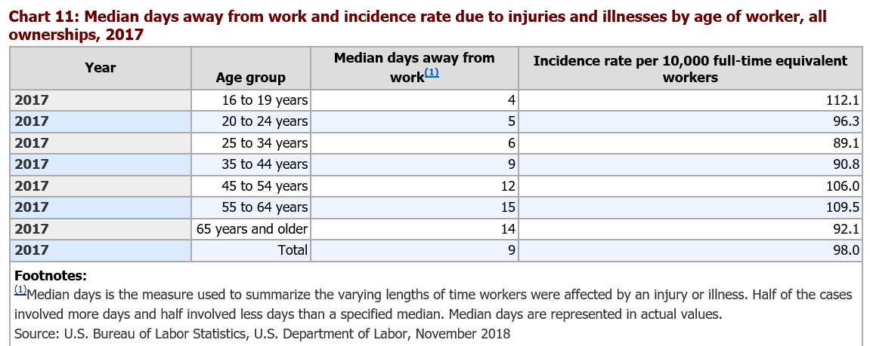



https://www.bls.gov/iif/soii-chart-data-2017.htm
Notes:
INJURY INCIDENCE RATES BY AGE GROUP
Highest incident rate among 16-19 age group
AGE 65 and up is towards the bottom at 92.1! Excellent
Make sure you focus on trip/fall hazards

Slide 24
Aging and physical changes
MUSCULAR STRENGTH AND RANGE OF JOINT MOVEMENT (Muscles, bones, joints, ligaments, tendons)
  15%-20% Loss of strength from ages 20-60
  Musculoskeletal system weakens
    Decreased capacity for load-bearing work
    Working closer to maximum level compared to younger workers
    Cartilage (padding between bones) deteriorates
    Bones become more porous (more likely to fracture)
  Loss of range of motion and flexibility
https://www.ccohs.ca/oshanswers/psychosocial/aging_workers.html
Notes:
MORE BENEFITS OF AGING
After age 30, there is a 3–5 % loss of muscle mass per decade, with a higher decline after age 60,
Muscles are sore…joints hurt….EPSON SALT is our friend
Work at capacity sooner
Bones become more porous…More likely to sustain fractures with falls/injury
This is something we can definitely get a little control over – exercise and staying active..

Slide 25
Employer - to do
Provide equipment for lifting and moving loads.
Minimize need for lifting.
  Store at lower levels or pack in smaller quantities
Provide ergonomic friendly work stations.
  Grip-friendly tools, Adjustable seating
Train – Lifting, Bending, Stretching
Offer stretch breaks
Mark steps, floors and inspect walking surfaces
https://alis.alberta.ca/media/2894/agingworkforce.pdf
Notes:
ERGO FRIENDLY EQUIPMENT
Store often-needed materials at waist level
– LIFT TABLES – ASSISTED LIFTING – LIFTING LIMITS (ie – over 40 lbs get help)
TRAIN proper lifting
Make sure employees know how to use equipment
(go to gym and don’t use it strictly because you don’t know how….then when you do it’s your favorite!
Train for use
NO TWISTING AND LIFTING
Company that stretches before each work day

Slide 26
Aging and physical changes
CARDIOVASCULAR AND RESPIRATORY SYSTEM
  Ability of the heart, lungs, and circulatory system to carry oxygen decreases
    AGES 30-65 – Breathing capacity can reduce by 40%
      Reduction in physical labor ability
  Constriction of blood vessels
      Reduction in ability to regulate body temperature
        Increases risk of hyperthermia (heat stroke)/hypothermia (frost bite)
https://www.ccohs.ca/oshanswers/psychosocial/aging_workers.html
Notes:
Cardiovascular changes
Maybe notice shortness of breath faster than we used to –
Affecting our work capacity
Working at our full capacity earlier
Reduced circulation making older workers more susceptible to injuries related to temperature extremes
Vasodilatation/vasoconstriction
Affect ability to regulate body/core temperature
More susceptible to heat exhaustion or hypothermia

Slide 27
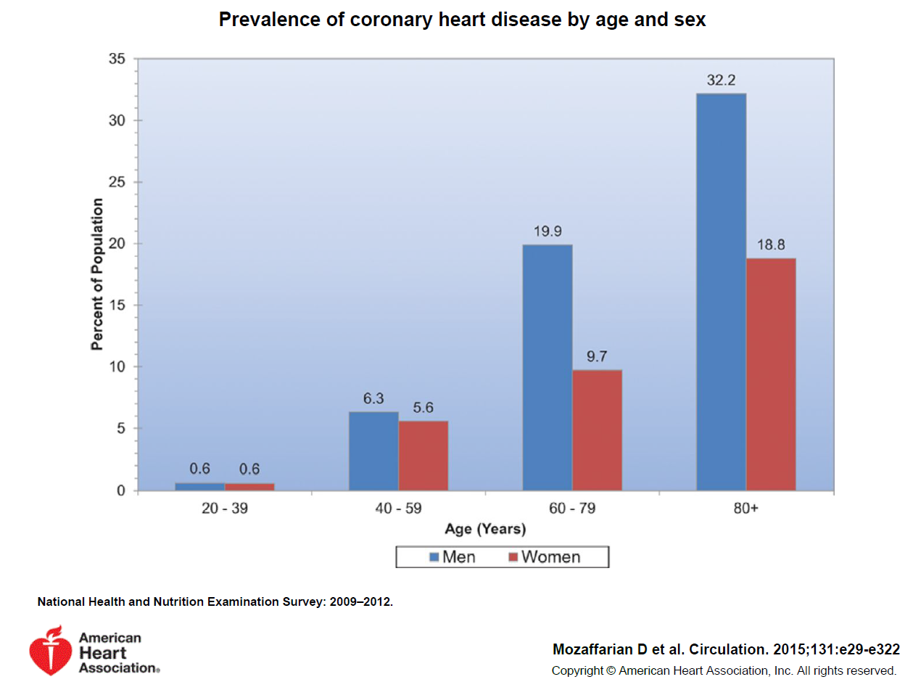

FIRST AID
https://www.heart.org/idc/groups/heart-public/@wcm/@sop/@smd/documents/downloadable/ucm_449846.pdf
Notes:
Each year, about 10,000 sudden cardiac arrests occur at work.
What can we do? BE PREPARED! EAP – PRACTICE DRILLS
First aid trained – CPR – AED!!!
Chances of survival of cardiac arrest decreases by about 10 percent per minute without immediate CPR or AED
Angie – 911 = 9+911

Slide 28
Employer – to do
Minimize lifting requirements
Avoid/Adjust work in extreme temperatures
Assign/Schedule work to avoid fatigue
Provide comfortable working temperature
Notes:
What else can employers do -
AVOID OVEREXERTION
Be cognizant of conditions such as extreme temperatures and additional factors due to age and physical conditions that may impact safety

Slide 29
Aging and physical changes
BALANCE
  Frequency of accidents associated with losing balance increases with age
SLEEP
  Aging negatively impacts body’s ability to regulate sleep – changing work hours, light, noise.
BODY TEMPERATURE
  Less able to maintain internal temperature/adjust to external temperature
    Overheated more easily
https://www.ccohs.ca/oshanswers/psychosocial/aging_workers.html
Notes:
BALANCE IS A BIG ONE – FALLS
REMEBER - Workers in age group ≥65 years had the highest RISK of FATAL FALLS.
common reasons for falls: health conditions, inner ear issues/meniers disease, Muscle weakness, medications
Environmental factors such as the wet floor, high heels, dim light, trips/falls
DO STABILITY EXERCISES - HELPS IMPROVE BALANCE – LESSENS FALL RISK
Never too early to start
Interrupted sleep – not quality sleep – tossing/turning – Charlie horses!
LEADS TO TIRED EMPLOYEES/IRRITABLE/NOT FOCUSED

Slide 30
Aging and physical changes
VISION
  Difficulty seeing/reading from certain distances
  Changes in peripheral vision
  Changes in visual acuity (fuzzy)
  Depth perception
  Resistance to glare/light transmission
    Lighting and avoiding small print are important
HEARING
  Decrease in ability to hear higher pitched sounds
    Difficulty with noisy environments/background noises
https://www.ccohs.ca/oshanswers/psychosocial/aging_workers.html
Notes:
CAN’T READ A THING - cheaters
increased all font on phone
More sensitive to glare – need additional light!!
glaucoma
AGE RELATED HEARING LOSS

Slide 31
Employer – to do
Housekeeping
Adequate lighting
Use back-up warning systems (lights)
Reduce/Control workplace noise exposure
Provide PPE
Encourage regular medical examinations
Notes:
FOCUS on HOUSEKEEPING! SIMPLE AND EFFECTIVE!
pick up cords, pick up spills quickly, have non-skid floors
Lighting – older workers are more sensitive to glare so they may need additional lighting
Dim lighting, material in aisleway – perfect storm…
Medical examinations may find health issues before becoming a factor in a workplace injury.
(ie get glasses prescription up to date)

Slide 32
Older workers rock! (and not in chairs)
Knowledge:
  Work experience
  Life experience
More productive work habits
  Safer work habits – follow rules
Lower stress levels related to work
Get along with co-workers. Friendly folks!
https://www.cdc.gov/niosh/topics/productiveaging/safetyandhealth.html
Notes:
Older workers are an extremely valuable asset to employers.
Have been with company, knows job, knows policies
Appreciates work
SO FRIENDLY

Slide 33
Older workers rock!
Strong Work Ethic
Reliability
Lower Turnover Rate
Role Models/Mentor
Emotional Maturity
https://www.cdc.gov/niosh/topics/productiveaging/safetyandhealth.html
Notes:
UNDENIABLE WORK ETHIC –
TAKE ADVANTAGE FROM ALL OF THE EXPERTISE AND EXPERIENCE YOUR OLDER WORKERS HAVE
Let them mold the younger workers coming in
Bring them together
Use younger workers teach older technology
Older workers teach younger workers the job and it’s value
Don’t’ work for a week and quit
NOT saying all generations aren’t like this but today we want to embrace the older workers for these qualities.
Younger workers can learn the job from them

Slide 34
Older workers rock! (bruce Springsteen is 70!)
Workplace Loyalty
Less Supervision
Lower Absenteeism
Economic security
Social Interaction
Quality of life
https://www.cdc.gov/niosh/topics/productiveaging/safetyandhealth.html
Notes:
LOYAL
Tend to come to work and not call off…..less partying
Me, I don’t go out anymore and am in bed by 9:30
NOT good for me but is a good thing for my employer!
working provides
-financial security
-means to socialize.
My Lonely job - depend on all of you to be my friends when I visit – so be nice to me when I come
Quality of life –– “I have to keep moving” “it gives purpose” a sense of being needed.

Slide 35
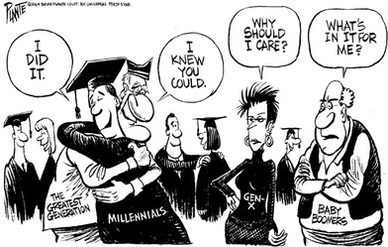
Notes:
Shows different characteristics are associated with the different generations and how we learn is one of the them.
Baby boomers – want to know whats in it for them
SO – APPLY THIS TO TRAINING
Understand and have respect for these differences and let it help you communicate and train

Slide 36
Training
Justify logic “What’s in it for me?”
May be resistant to learning “new ways”
Remember – EVERYONE learns differently
Provide supportive learning environment
Use small groups
Self-paced learning
Build on the familiar with connection to experience
Avoid information overload
Consider instruction by peer workers of same age
https://www.nia.nih.gov/health/how-aging-brain-affects-thinking
Notes:
Training the older worker – BUILD ON WHAT THEY ALREADY KNOW
May be resistant to learning new ways of doing things – normal for a lot of people
Older workers may be learning DOUBLE what younger generations..
how to do a task AND
2) how to learn with the new TECHNOLOGY they’ve never used (easier and more natural for younger)
DOUBLE LOAD OF LEARNING!
Self-paced learning is a great option - removes the pressure aspect
I enjoy our computer based learning that we do at bwc

Slide 37
Be proactive!
Manage/ELIMINATE Hazards
  Noise – distracting, hearing loss
  Slip/Trip hazards – cords, rugs, damaged flooring, wet/slippery flooring
  Chairs – adjustable
  Lighting
Workplace design – work surfaces, lighting
Ergonomic interventions – orthotics, lift assist (lift tables) – every age!
MANY ACCOMMODATIONS ARE EASY AND INEXPENSIVE (safety grant)
Your friends at BWC Will Help!
https://www.cdc.gov/niosh/topics/productiveaging/safetyandhealth.html
Notes:
What can employers do?
Identify and address hazards
Noise survey - ensure use of PPE if required – hearing protection not being worn “I’m already hard of hearing”
Aisle ways clear
Ergonomic assessment
Many Workplace accommodations are easy & inexpensive (especially compared to injury costs)
and good for ALL – NOT JUST OLDER WORKERS

Slide 38
Age-friendly workplace
Promote health and healthy lifestyles
  Provide physical activity opportunities
    Walking groups, yoga/stretching, gym membership group discounts
  Sit-stand work stations
  Healthy meal options – what do you have in your vending?
  Smoking cessation assistance
  Health screenings (BYBO!)
  On-site medical care – Flu vaccine clinic
  Accommodate (flexible) for health care visits.
https://www.cdc.gov/niosh/topics/productiveaging/safetyandhealth.html
Notes:
*Walking breaks
*healthy food options - How many of us have just gone and stared blankly into the vending machine
*Assistance programs – provide informational materials
*Flu can cause serious complications on those 65 and older. May be cost effective to offer flu vaccine than have sick employees (health care costs, sick days, etc)
Vaccinate for family members and coworkers - can’t be any easier, drug stores practically vaccinate you as soon as you walk through the front door
Encourage sick people to keep distance or stay home
*allow for doctor visits – it’s important to take care of ourselves and going to the doctor is how we do that
Sit – stand desk!
ENCOURAGE staying active - Whatever helps and make you feel better!
Keep it fun, keep employees moving
This provides for good company morale as well!
Feeling good!

Slide 39
Age-friendly workplace
Flexibility (workers prefer this over additional vacation days!)
  Flexible schedule
  Work location
    Flexibility of work schedule – part-time shift, job-sharing, work from home
Tasks
  Match to ability
  Self-paced work
  Self-directed rest breaks
  Less repetitive tasks
https://www.cdc.gov/niosh/topics/productiveaging/safetyandhealth.html
Notes:
If we really want to go for it…
Flexible work hours
Job sharing/part timers – happy medium if don’t want to work full time but don’t want to retire
Allow needed breaks
*ASSIGN tasks that do not require them to strain beyond their ability.
*look for and reduce repetitive tasks that may over time lead to cumulative trauma injuries like carpal tunnel syndrome

Slide 40
Age-friendly workplace
Return to work after injury
  Provide/manage accommodations to return to work
Train management skills for supervisors
  Effective ways to manage multi-generational workplace
https://www.cdc.gov/niosh/topics/productiveaging/safetyandhealth.html
Notes:
*Return to work program!
Bring back modified duty (and discount program)
Bring back as soon as possible – not only good for employer but good for the employee as well!
*Train supervisors on the issues associated with an aging workforce and the best ways to address them.

Slide 41
TRUE OR FALSE?
In most cases, training and adaptations can improve workplace safety and offset effects of changes related to aging.

Slide 42
TRUE!
Notes:
TRUE yes! We can help them help us!
A well-designed, employee-centered approach benefits all workers regardless of their age

Slide 43

Notes:
Saw this and wanted to share
Nice reminder that It’s not all about us………………….
…………………………………………………….

Slide 44
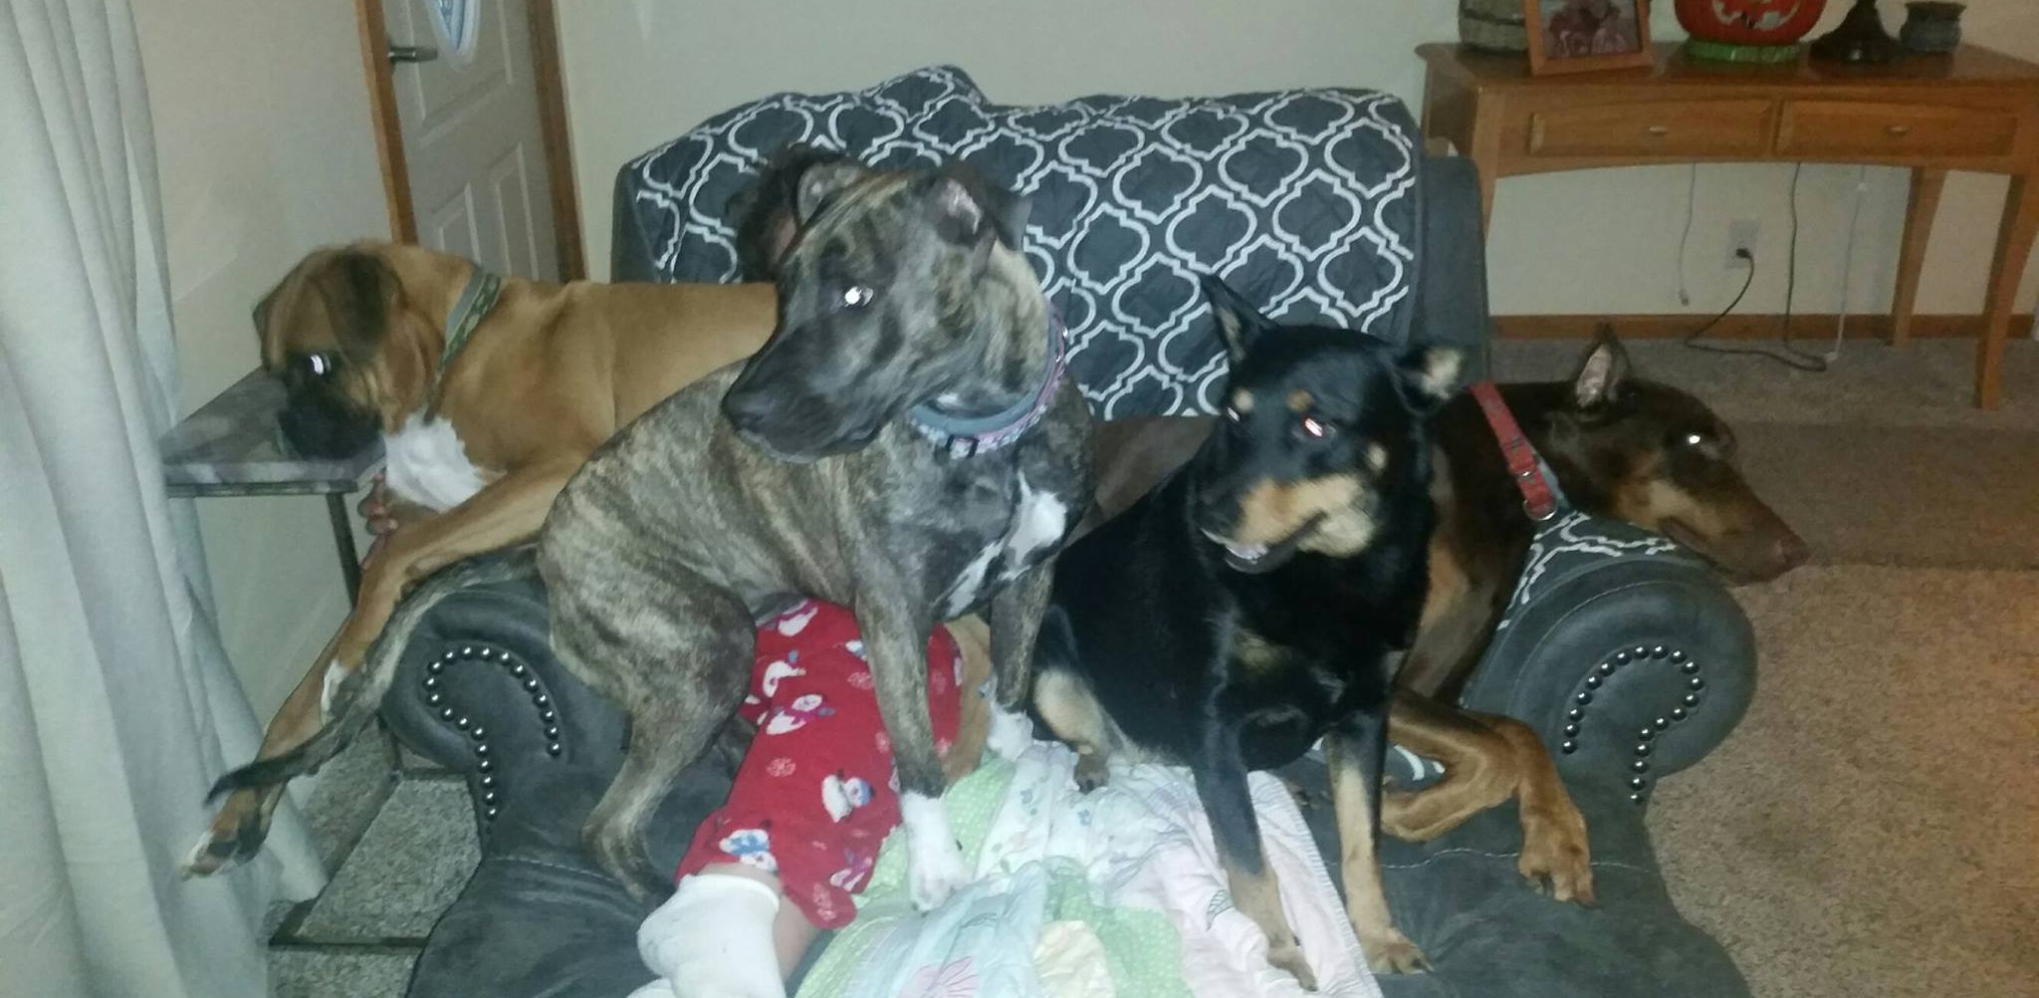
Notes:
I dare you to try and find a place to sit at my house.
Little PERSON!

Slide 45

Notes:
QUESTIONS

